Slide 1



Recommendation System for
E-Commerce
Predicting User Purchase History
by SHIKHA YADAV
Btech CSE(AI & ML)

Slide 2

INTRODUCTION
Objective: To develop a recommendation system that predicts the next purchases of users
based on their past behavior using deep learning techniques.
Dataset: Amazon Beauty Products dataset from Kaggle.
Techniques Used:
Data Preprocessing
Sequential Data Modeling
Deep Learning (LSTM)
Evaluation Metrics

Slide 3
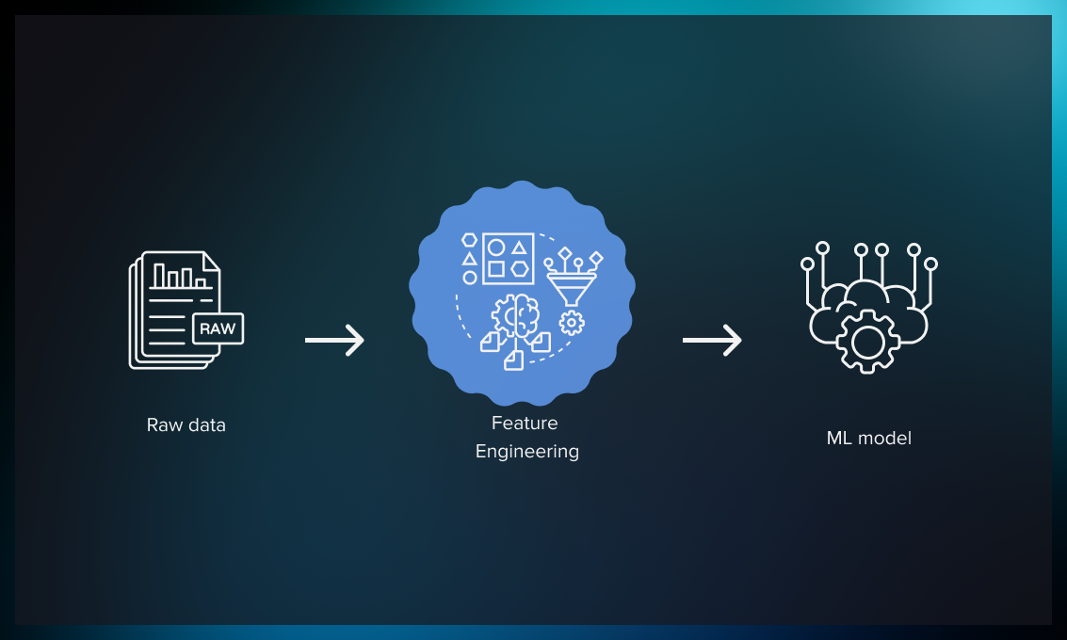
Data Pre-processing and Feature Engineering
Steps Involved
Data Cleaning:
Dropped missing values, 'Timestamp', and 'Rating' columns.
Aggregating Product IDs:
Grouped product IDs for each user to capture purchase sequences.
Tokenization and Sequence Preparation:
Converted product IDs into numerical sequences.
Padded sequences to ensure equal length for LSTM input.

Slide 4
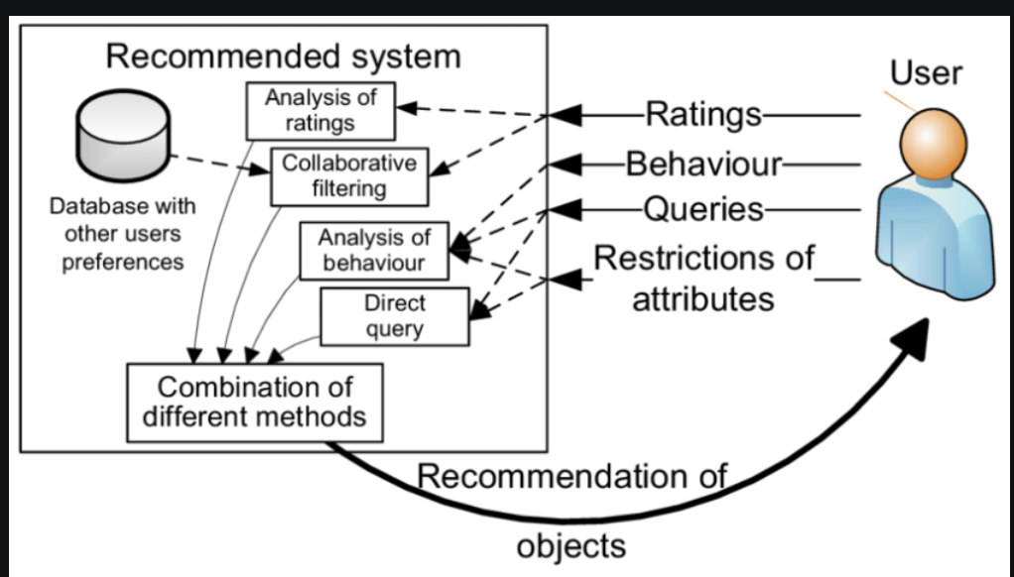
MODEL ARCHITECTURE
Model Used: Long Short-Term Memory (LSTM) Network
Layers:
Embedding Layer:
Transforms product IDs into dense vectors.
LSTM Layer:
Captures temporal dependencies in purchase sequences.
Dense Output Layer:
Outputs probabilities for the next product.

Slide 5
MODEL SUMMARY
Architecture
Embedding Layer: 50-dimensional vectors
LSTM Layer: 100 units
Dense Layer: Soft max activation for multi-class classification
Compilation
Loss: Categorical Cross entropy
Optimizer: Adam
Metrics: Accuracy

Slide 6
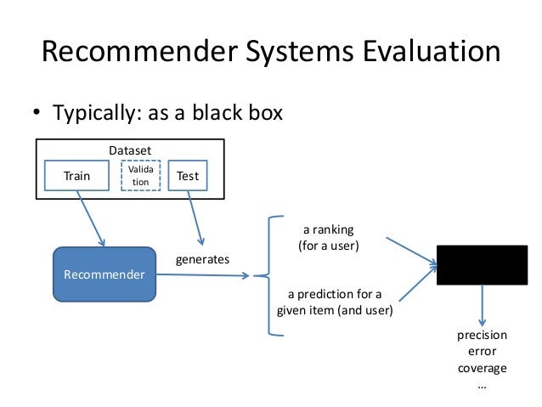
TRAINING AND EVALUATION
Training:
Epochs: 20
Batch Size: 32
Validation Split: 20%
Evaluation Metrics:
Accuracy: General performance measure
Log Loss: Confidence of predictions

Slide 7
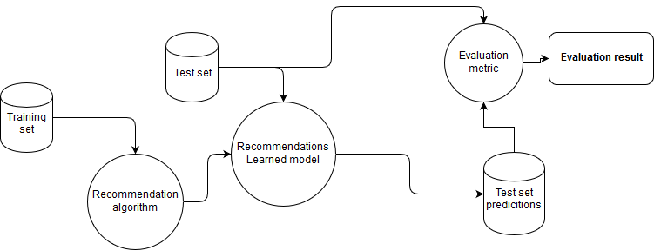
MODEL PERFORMANCE
Results:
Training Accuracy: [Insert Value]
Validation Accuracy: [Insert Value]
Log Loss: [Insert Value]
Insights:
Effective in capturing purchase patterns
Higher accuracy with more epochs and larger dataset

Slide 8
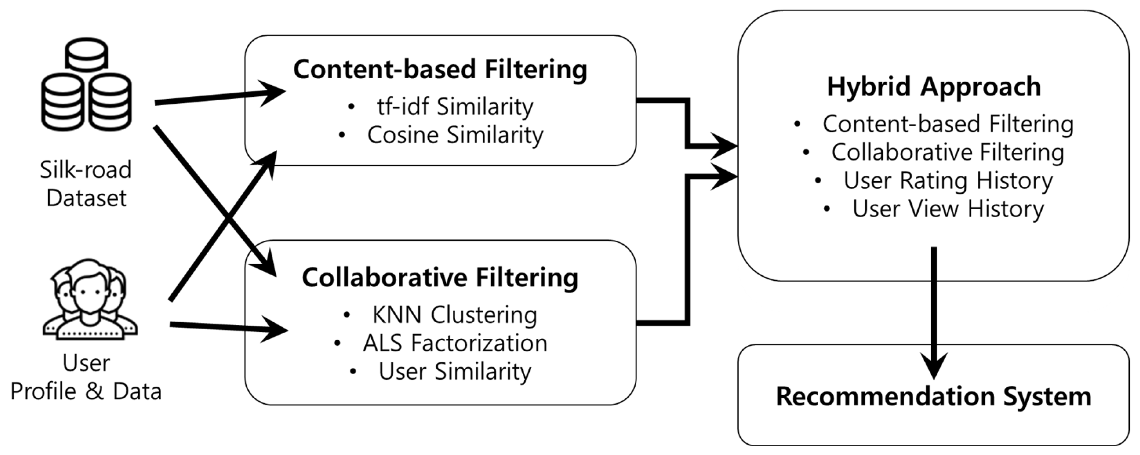
CHALLENGES AND INSIGHTS
Insights:
Data Cleaning: Crucial for model accuracy.
Embedding Layer: Enhances input representation.
LSTM: Suitable for sequential data.
Challenges:
Dataset Size: Limited dataset may impact generalization.
Assumption of Sequential Patterns: May not always hold true.
Static Embeddings: Dynamic embeddings could improve accuracy.

Slide 9
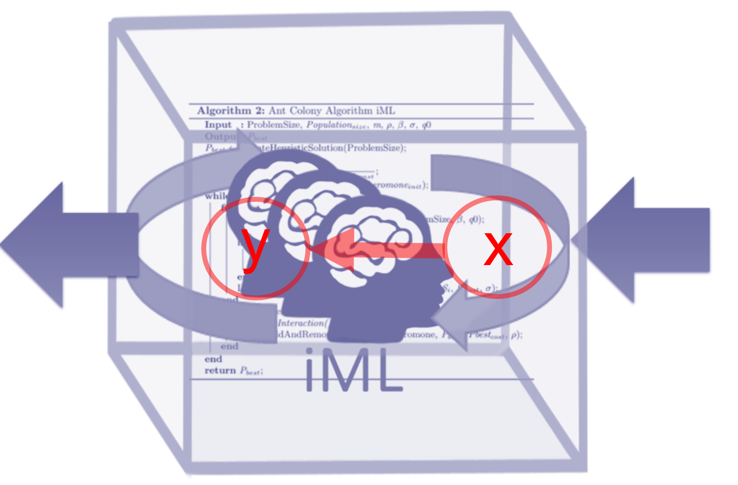
FUTURE DIRECTIONS
Future Work:
Incorporate Additional Features: Product categories, user demographics, temporal aspects.
Hybrid Models: Combine LSTM with collaborative filtering or content-based methods.
Real-Time Recommendations: Implement dynamic updates based on user interactions.
A/B Testing: Validate model effectiveness in a live environment

Slide 10
Developed a deep learning-based recommendation system.
Leveraged LSTM to predict user purchase sequences.
Evaluated model using comprehensive metrics.
Identified areas for improvement and future research.
CONCLUSION

Slide 11
THANK
YOU

